Slide 1
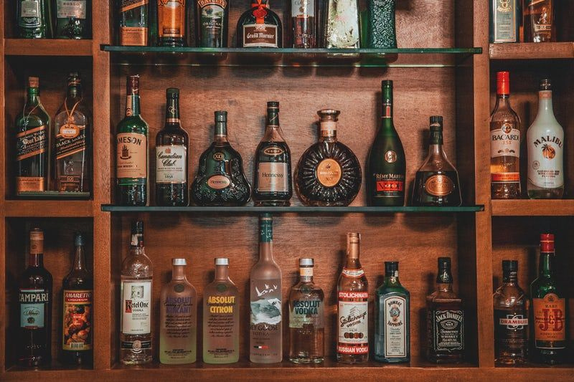



SQL PROJECT TOPIC
LIQUOR SALES AND MANAGEMENT SYSTEM

Slide 2


Content
01
02
03
04
05
Title
Statistics
Introduction
Purpose
DBT Diagram
06
07
08
09
10
Tables
Advantages
Future Scope
Business Queries
Conclusion

Slide 3

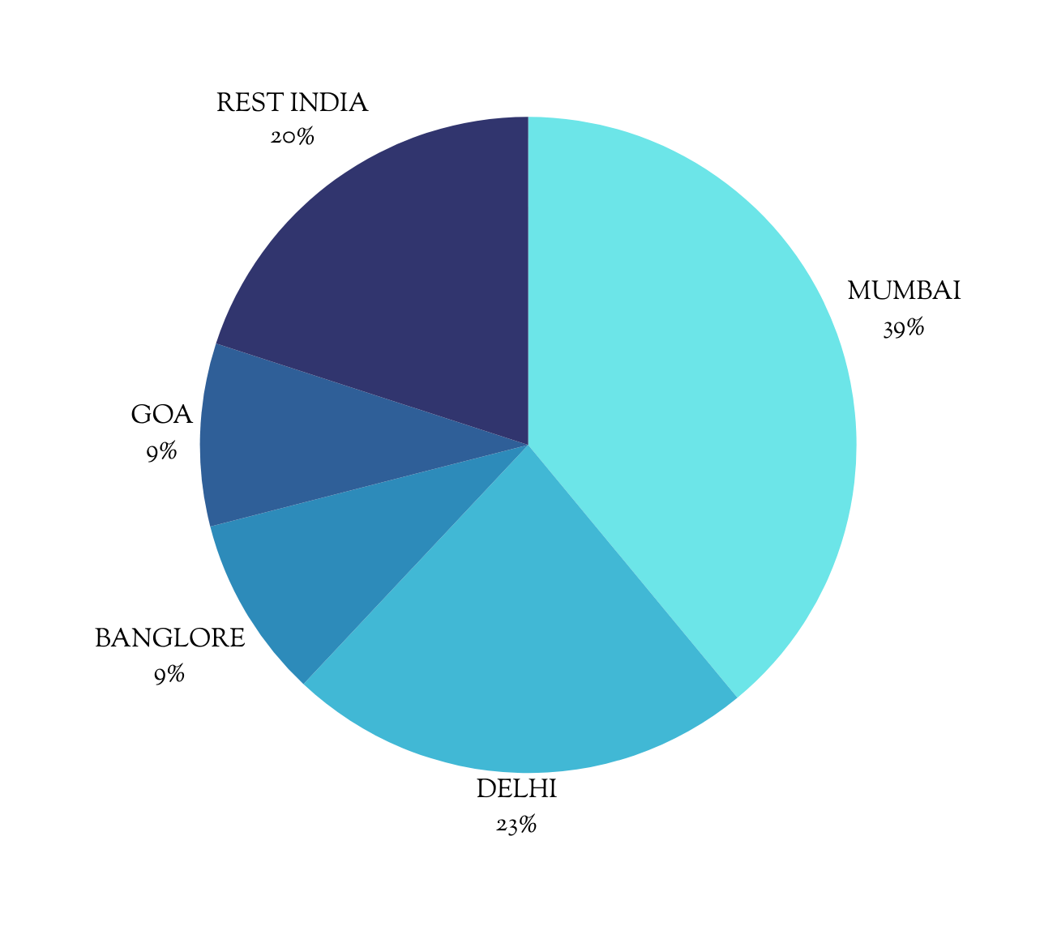
STATISTICS

Slide 4
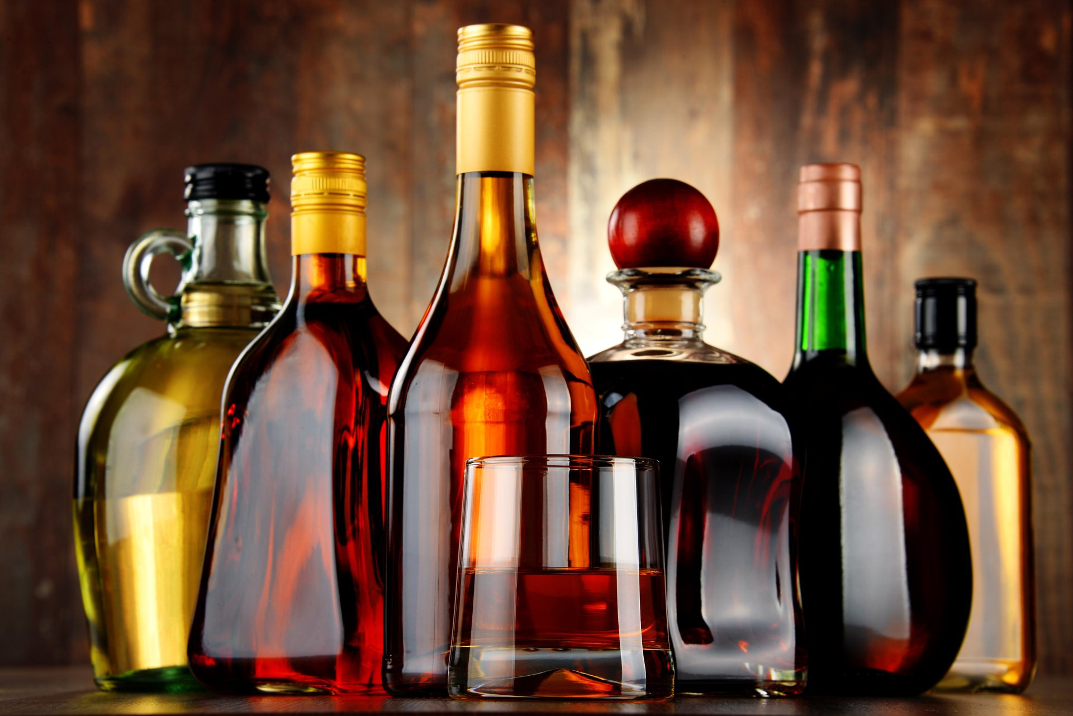


INTRODUCTION
Liquor sales management is about keeping track of alcohol products that are sold. It involves managing inventory, sales, and customer information. This is important for businesses to track what they sell, how much they have, and who they sell to. It helps businesses make decisions about what products to stock, how to price them, and how to improve their sales.

Slide 5





PURPOSE AND IMPORTANCE
Customer Relationship Management
Easy data analysis
Employee Productivity
Promotion Management

Slide 6

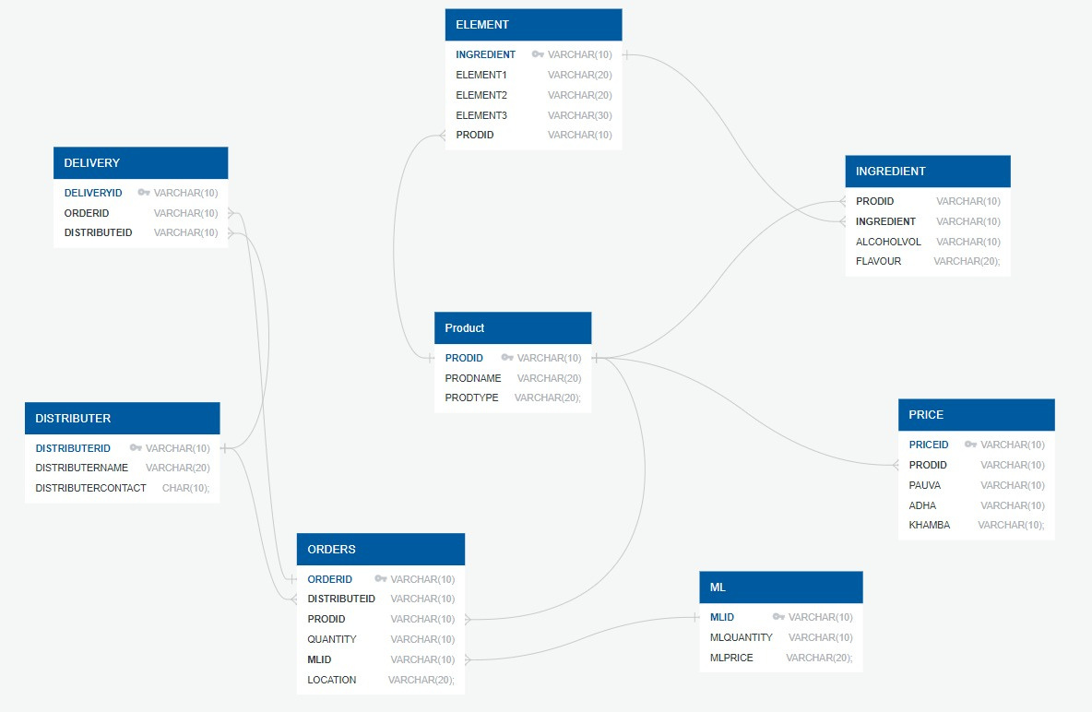
DATABASE TABLE DIAGRAM

Slide 7
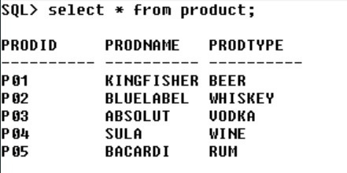
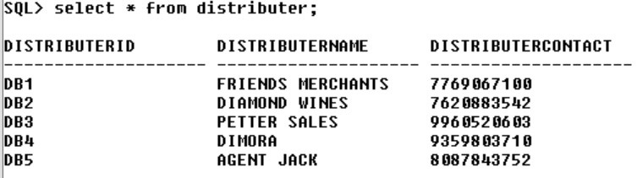
PRODUCT TABLE
DISTRIBUTER TABLE

Slide 8

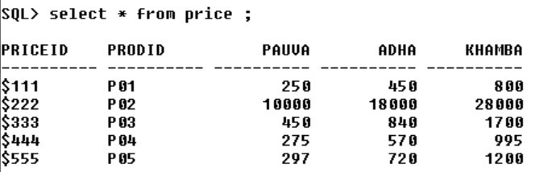
PRICE TABLE

Slide 9
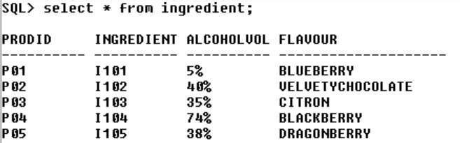
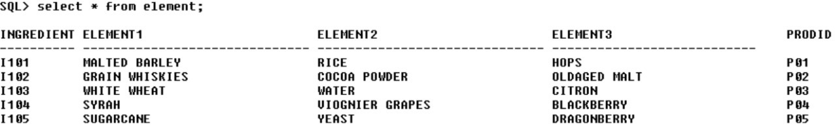
INGREDIENT TABLE
ELEMENT TABLE

Slide 10
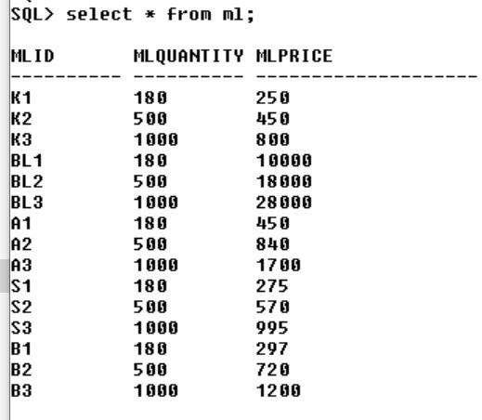
ML TABLE

Slide 11
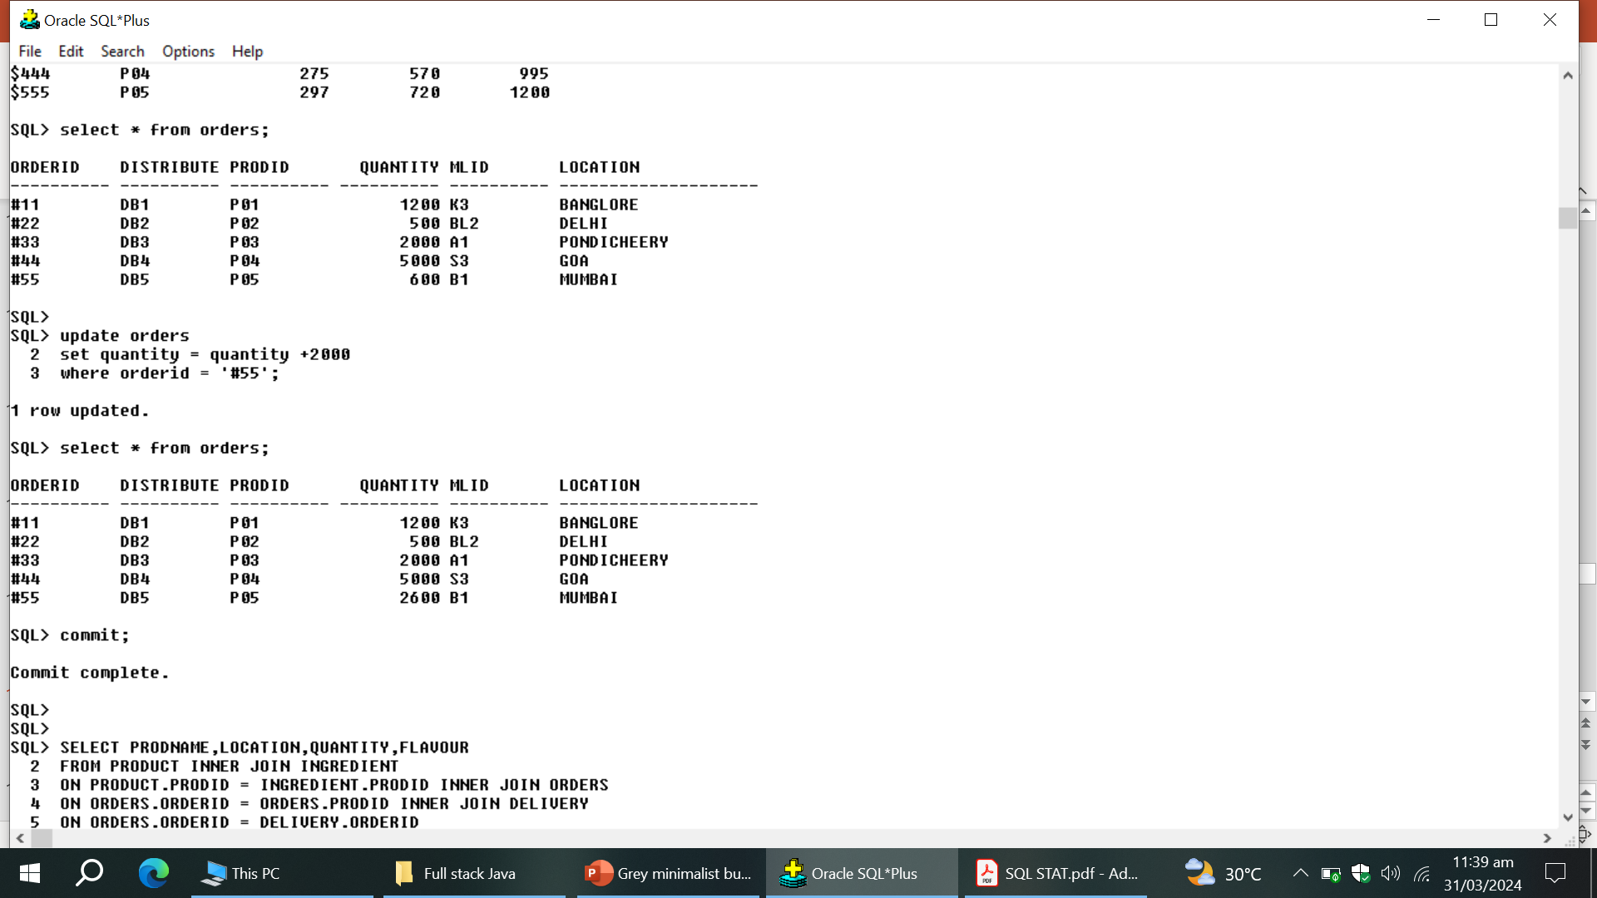
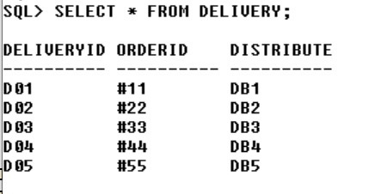
ORDERS TABLE
DELIVERY TABLE

Slide 12
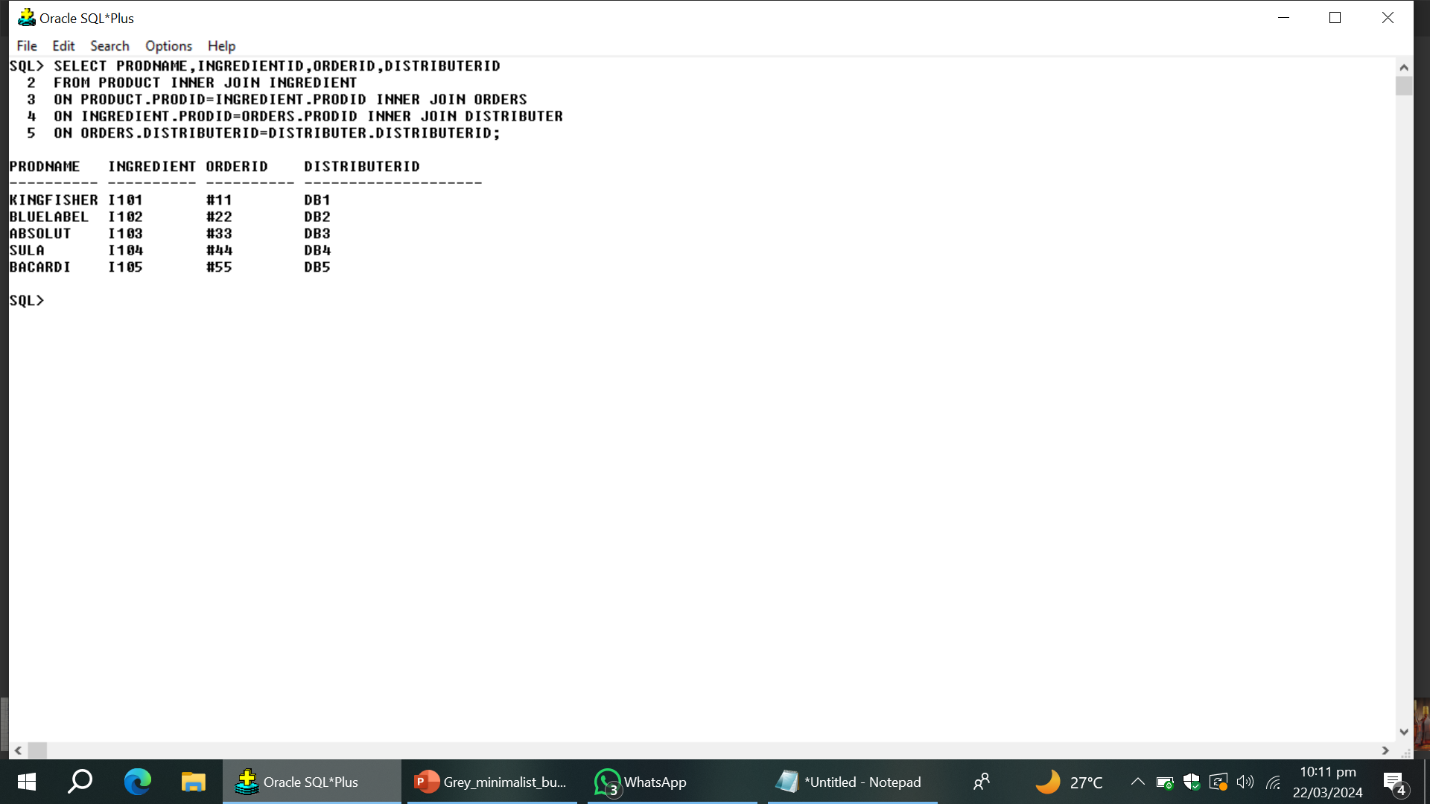
BUSINESS QUERIES
Q 1) To Display the Product name ,product ingredient information ,order details and Distributer name

Slide 13
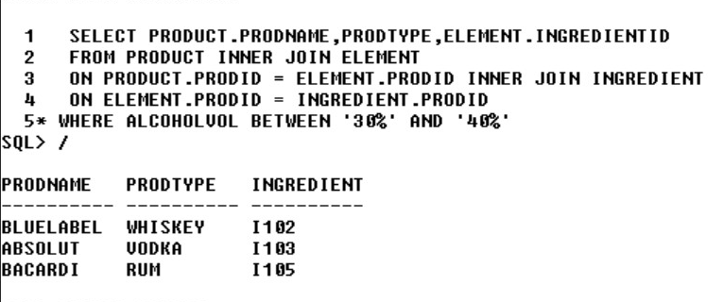
Q2 ) To Display the product name , name of product type ,element details and ingredient ID . if alcohol
volume is greater than 30% and less than 40 %

Slide 14
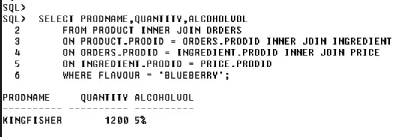
Q3 ) TO DISPLAY THE PRODUCT NAME ,PRODUCT QUANTITY ,ALCOHOL VOLUME IF THE ORDERS PRODUCT
FLAVOUR IS BLUEBERRY

Slide 15
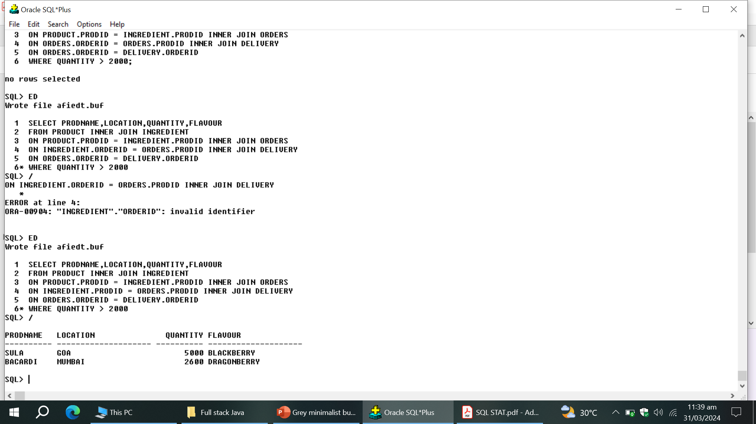
Q4 ) TO DISPLAY PRODUCT NAME, ORDER LOCATION , PRODUCT QUANTITY AND PRODUCT FLAVOUR .
IF THE ORDER IS GRETER THAN 2000 QUANTITY

Slide 16
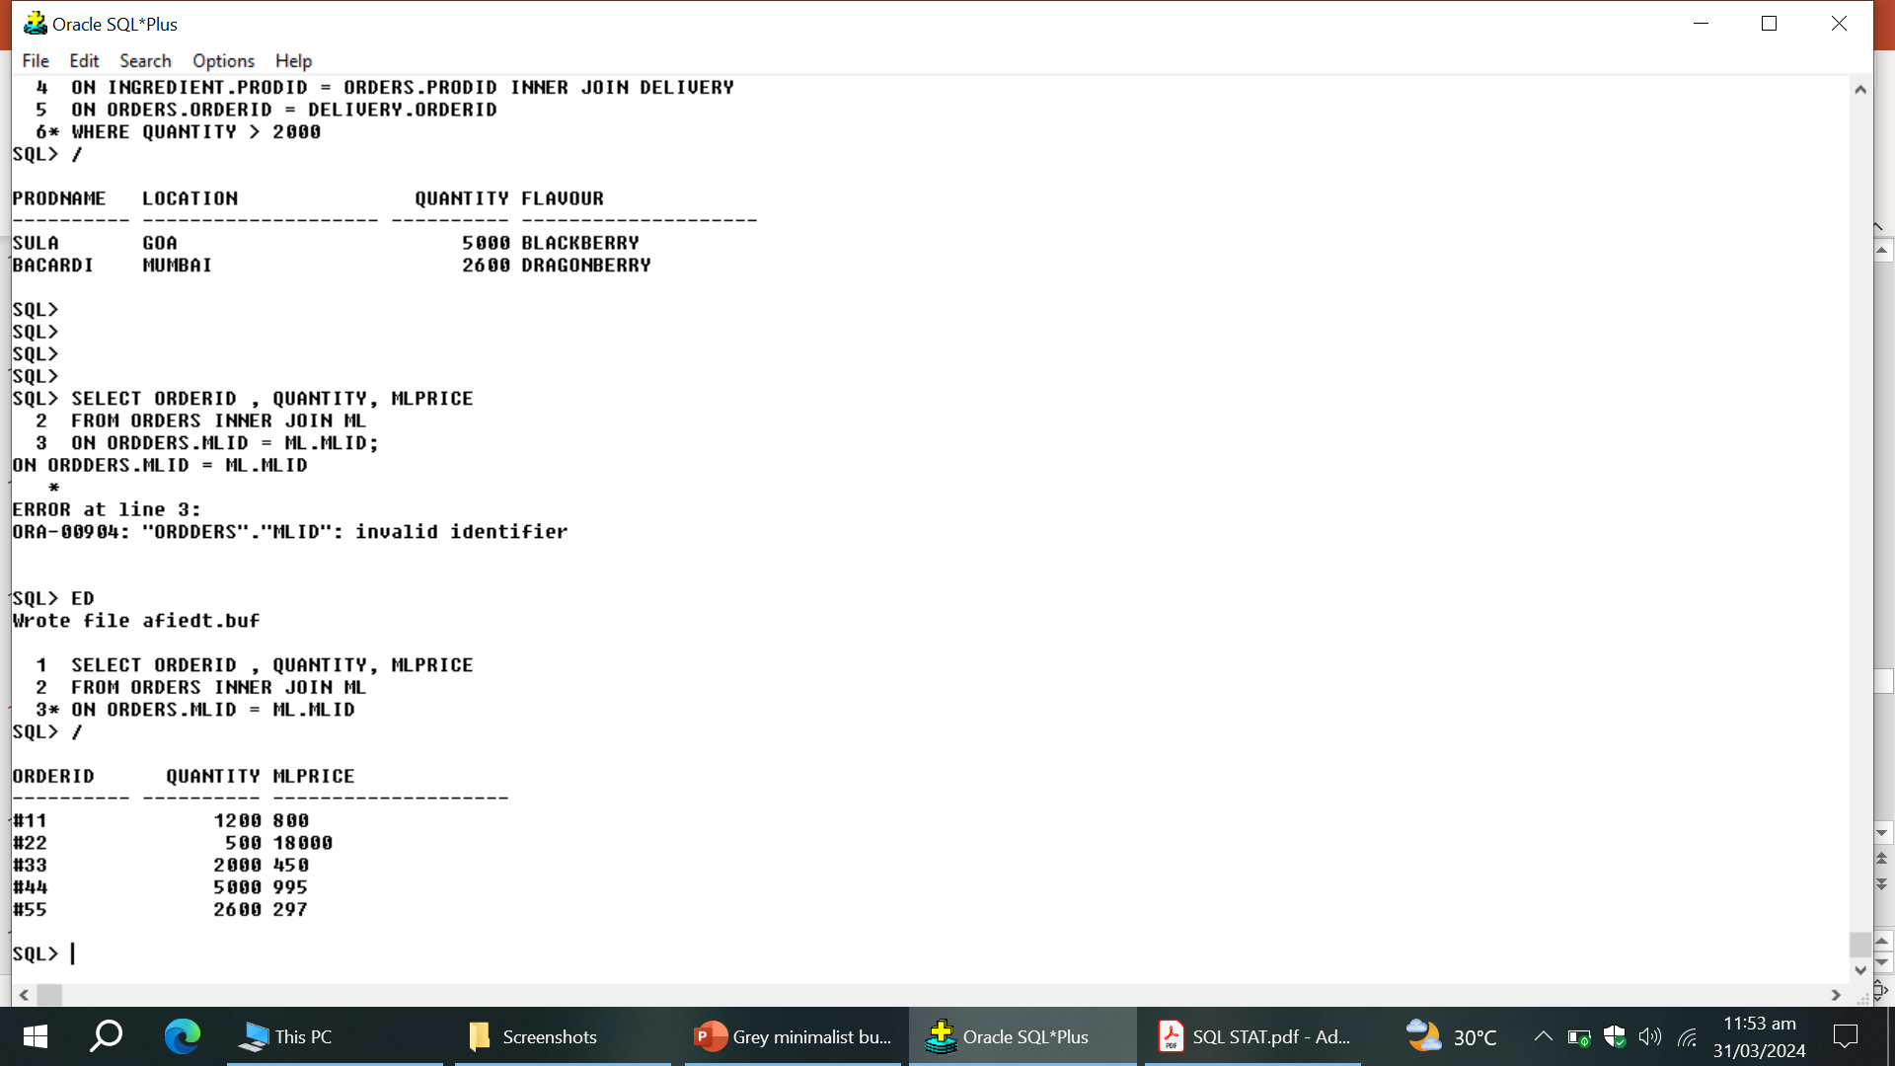
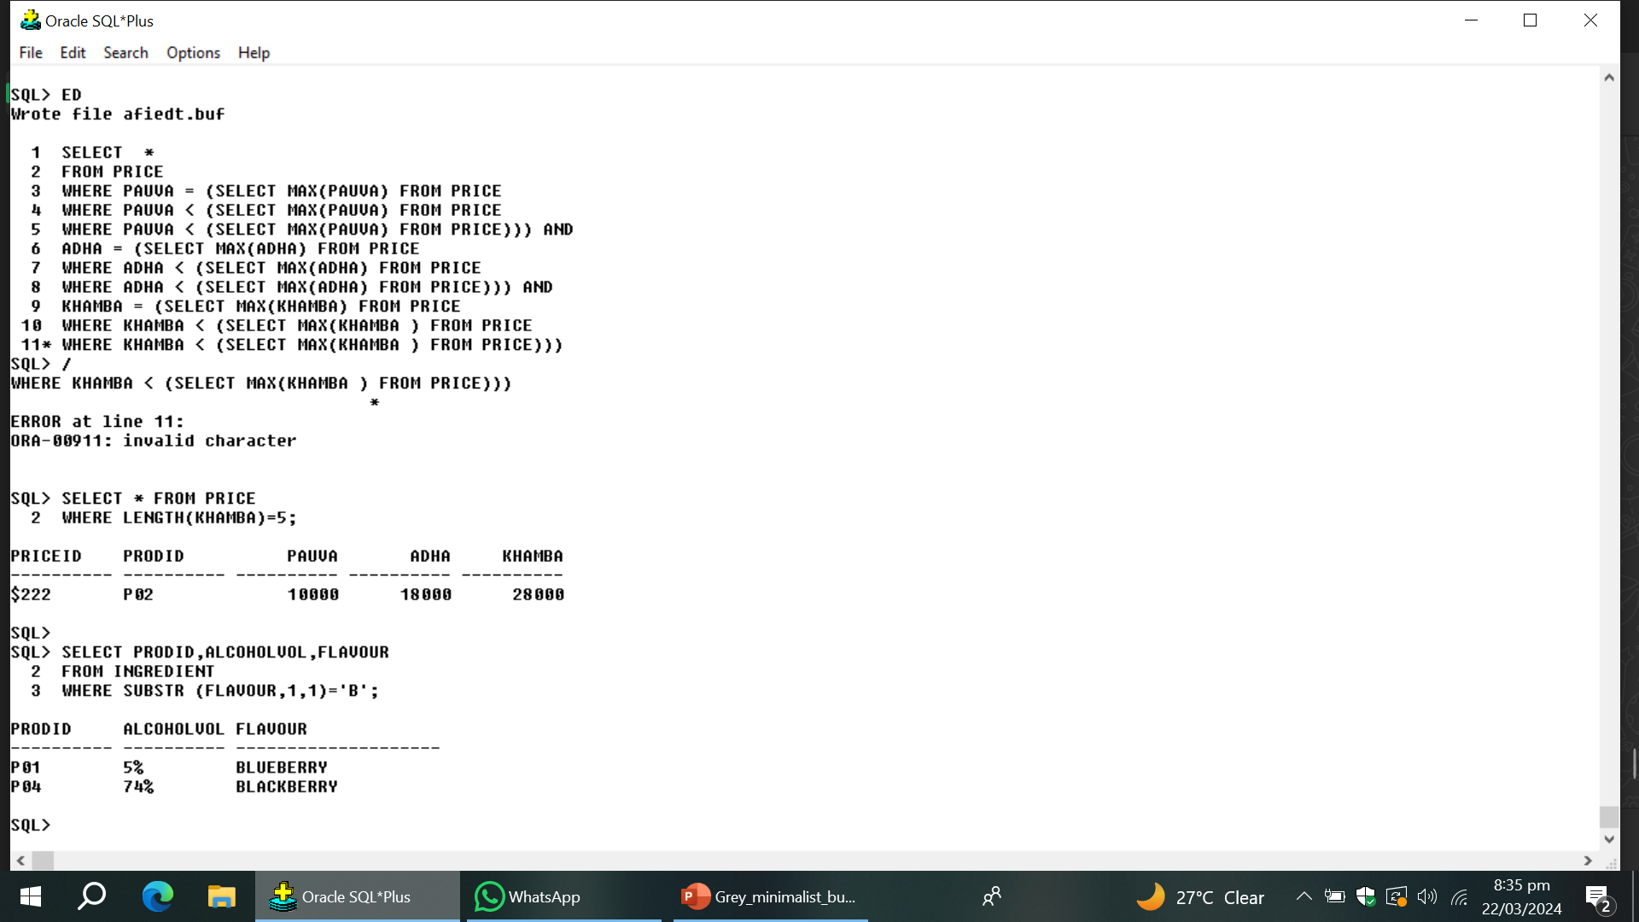
Q5 ) DISPLAY THE ORDER ID , ORDER PRODUCT QUANTITY AND ML PRICE OF THE PRODUCT .
Q6 ) DISPLAY THE PRODUCT ID , ALCOHOL VOLUME AND FLAVOUR . IF THE FLAVOUR FIRST CHARACTER
IS ‘ B ’

Slide 17

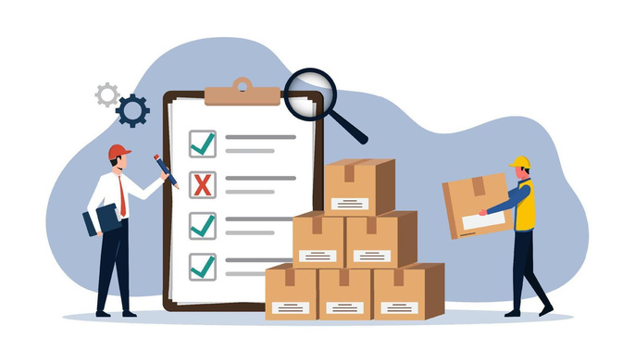



A
D
V
A
N
T
A
G
E
S
INCOME SOURCE FOR FARMERS
INVENTORY CONTROL
DATA ANALYSIS
LOSS PREVENTION

Slide 18




FUTURE IMPROVEMENT
Global, Marketplace Expansion
Customers Insights
Stocks Launch

Slide 19




























CONCLUSION
In conclusion, our Liquor Sales Management project aims to empower liquor businesses with the tools and insights. By utilising the potential of technology, we aim to revolutionize liquor sales management and propel the industry towards sustainable growth and success. Cheers to a successful and streamlined future.

